Slide 1


www.cambridge.edu.in
Project Work Phase – II
Subject Code:18AIP83
Project Name:
Querying Multiple PDFs
Presented By :
Rebanpaul R Syngkli 1CD21AI047
Noel Sam 1CD21AI036
Department of Artificial Intelligence and Machine Learning

Slide 2
Abstract
The project "Querying Multiple PDFs" leverages the Gemini model to efficiently extract, analyze, and retrieve information from a collection of PDF documents. By utilizing advanced natural language processing(NLP) techniques, the system enables users to perform complex queries across multiple PDFs, extracting relevant data and insights with high accuracy. The Gemini model's capabilities in text understanding and contextual analysis ensure comprehensive and precise responses, making it a powerful tool for research, data mining, and information retrieval in various domains.
Department of Artificial Intelligence and Machine Learning www.Cambridge.edu.in

Slide 3
Introduction
In the digital age, the proliferation of information stored in PDF format poses a significant challenge for efficient data retrieval and analysis. PDF documents are widely used across various industries, including academia, business, and government, often containing critical information that needs to be accessed and analyzed. However, querying and extracting information from multiple PDF documents can be a time-consuming and complex task, requiring advanced tools and methodologies to handle the diverse and unstructured nature of the data.
By integrating the Gemini model's advanced text understanding and contextual analysis capabilities, the system will facilitate efficient data mining and information retrieval. This will benefit researchers, analysts, and professionals who need to sift through vast amounts of data to find specific information. The project's ultimate goal is to create a robust and user-friendly tool that enhances productivity and supports informed decision-making by simplifying the process of querying and analyzing multiple PDF documents.
Department of Artificial Intelligence and Machine Learning www.Cambridge.edu.in

Slide 4
Problem Statement
“Extracting and querying information from multiple PDF documents is often time-consuming and inefficient due to their unstructured nature. This project aims to develop a solution utilizing the Gemini model's advanced NLP capabilities to enable accurate and efficient querying of multiple PDFs.”
Department of Artificial Intelligence and Machine Learning www.Cambridge.edu.in

Slide 5
Applications:
Legal Research: AI can assist legal professionals in quickly locating relevant case law, statutes, and contractual clauses within extensive legal documents, improving efficiency and accuracy.
Academic Research: Researchers and students can benefit from AI-driven PDF querying to extract specific information, data, and references from research papers, theses, and academic articles.
Health Care: Medical professionals can use AI to search through medical records, research papers, and clinical trial data, facilitating faster access to critical information for diagnosis and treatment planning.
Business Intelligence: Companies can leverage AI to analyze financial reports, market research documents, and strategic plans, enabling informed decision-making and trend analysis.
Human Resource: HR departments can use AI to efficiently scan resumes, performance reviews, and policy documents, helping in recruitment, employee evaluations, and policy compliance.
Compliance & Auditing: AI can streamline the process of checking compliance with regulations by searching through corporate documents, contracts, and audit reports to identify relevant information.
Technical Documentation: Engineers and IT professionals can query technical manuals, user guides, and product specifications, quickly finding solutions to technical issues or information on specific components.
Department of Artificial Intelligence and Machine Learning www.Cambridge.edu.in

Slide 6
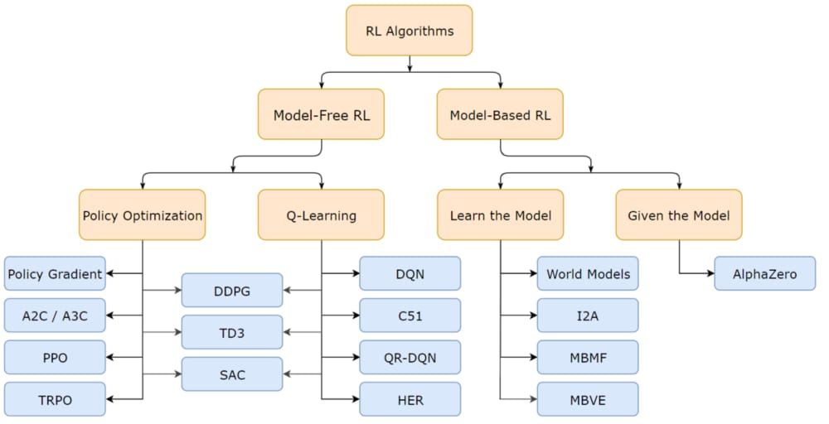
Department of Artificial Intelligence and Machine Learning www.Cambridge.edu.in

Slide 7
Literature Survey
SL NO | PAPER TITLE | JOURNAL NAME | DESCRIPTION | PROS | CONS
1 | Modular Reinforcement Learning for Playing the Game of Tron | IEEEXPLORE.IEEE.ORG | Demonstrate the algorithm based on MRL outperforms all previous algorithms on 6 6 and 8 8 grids. Although our algorithm shows slightly worse performance on 1010 grid than the strongest baseline a1k0n, we show that our algorithm exhibits better scalability in terms of time complexity as the grid size increases than search-based heuristics. | Modular Structure Competent Longest Path Approximation Outperforms a1k0n Algorithm Real-Life Applicability | Limited Scalability Dependency on Realistic States Higher Computational Costs Need for Further Research
2 | Playtesting in Match 3 Game Using Strategic Plays via Reinforcement Learning | IEEEXPLORE.IEEE.ORG | In Match 3 games, the game screen essentially comprises blocks and obstacles, and the players are required to solve missions assigned to each level before exhausting a given number of moves and the difficulty of a level is measured by the number of moves allowed for the level. The agent is trained to learn the best strategies by checking the current state of board and mission using a policy-based method. This method aims to find and remove blocks that can complete the mission, rather than to simply match blocks. MCST,CNN,A2C | Self learning models using reward system. Works on both labelled and unlabelled data. Real-Life Applicability | Describing the states. Dependency on Realistic States. Efficiency depends on strategies not pre-planned. Need for Further Research.
Department of Artificial Intelligence and Machine Learning www.Cambridge.edu.in

Slide 8
SL NO | PAPER TITLE | JOURNAL NAME | DESCRIPTION | PROS | CONS
3 | Multiagent reinforcement learning in extensive form games with complete information | IEEEXPLORE.IEEE.ORG | Associative Q-values are the expected utility of an agent in a game situation which is an estimate of the value of the subgame perfect equilibrium point.. Methodology: Multiagent reinforcement learning, Associative Q-value | Extension of Q-learning Associative Q-learning Dealing with Multiplicity of Nash Equilibriums | Limited Empirical Validation Complexity Assumptions
4 | A Review paper on Implementing Reinforcement Learning Technique in Optimizing Games Performance | IEEEXPLORE.IEEE.ORG | The objective of this research paper is to introduce a reinforcement learning agent in game that run the simulation of the game and produce improved results after each iteration. This research aims to explore the best and suitable RL algorithm that suit specific games. The Methodology includes Data Collection, Analysis and Results and Discussion. | Data Analysis helped to discover the relation between the algorithms and games to determine the best algorithm for a specified game on performance basis. | Need to promote more machine learning implementation on games with imperfect information. Need to promote a system that implements more than one Machine Learning algorithm based on a certain task.
Department of Artificial Intelligence and Machine Learning www.Cambridge.edu.in

Slide 9
Objectives
Develop Advanced Query Capabilities: Create an application that utilizes Generative AI and Machine Learning to interpret and respond to natural language queries with high accuracy and relevance.
Enhance Text Extraction: Implement robust text extraction techniques, including Optical Character Recognition (OCR) for scanned documents, to accurately capture text from diverse PDF formats and structures.
Ensure Contextual Understanding: Integrate advanced Natural Language Processing (NLP) models to understand the context of queries, enabling precise information retrieval even for complex and nuanced questions.
Improve Efficiency and Speed: Optimize the querying process to deliver fast and efficient search results, minimizing the time required to find specific information within large or complex PDF documents.
Support Diverse Document Types: Ensure compatibility with a wide range of PDF documents, including text-heavy reports, image-laden manuals, research papers, legal documents, and more.
User-Friendly Interface: Design an intuitive and user-friendly interface that allows users to easily input queries and navigate results, enhancing the overall user experience.
Department of Artificial Intelligence and Machine Learning www.Cambridge.edu.in

Slide 10
Adaptive Learning: Implement machine learning algorithms that adapt and improve over time based on user interactions and feedback, continuously refining the accuracy and relevance of query results.
Security and Privacy: Ensure robust security measures to protect sensitive information within PDF documents and maintain user privacy during the querying process.
Integration and Compatibility: Develop APIs and integration capabilities to allow seamless incorporation of the querying tool into existing workflows, software systems, and platforms used by professionals, researchers, and students.
Comprehensive Documentation and Support: Provide thorough documentation, tutorials, and support resources to help users understand and effectively utilize the application for their specific needs and use cases.

Slide 11
System Requirements Analysis
Hardware Requirements :
CPU : a multi-core processor ( INTEL Core i5,i7,i9 or AMD Ryzen 4000 + series )
GPU : NVIDIA GPUs are commonly used for this purpose ( GEFORCE GTX and RTX series )
RAM : 8GB to 32GB RAM
Software Requirements :
Operating System : Windows 10 or Windows 11
Python : Python 3 or Above
Storage : SSD ( min 256GB – Recommended ) and HDD
Department of Artificial Intelligence and Machine Learning www.Cambridge.edu.in

Slide 12
System Architecture
User Interface
Application Layer
AI & ML Layer
Document Processing Layer
Results display module
Query Processing Module
Response Generation Module
Text Extraction and OCR Module
NLP and Semantic Analysis Module
PDF Parsing Module
Indexing & Metadata Extraction Module
UI module
Machine Learning Model Training Module
Department of Artificial Intelligence and Machine Learning www.Cambridge.edu.in

Slide 13
Methodology
Storage and Database Layer
Security and Privacy Layer
Integration Layer
Monitoring and Analytics Layer
Indexing and metadata database
Document Storage
Authenticatoion and Authorization Module
Data Encryption Module
Usage Analytics Module
System Monitoring Module
API Gateway
Department of Artificial Intelligence and Machine Learning www.Cambridge.edu.in

Slide 14
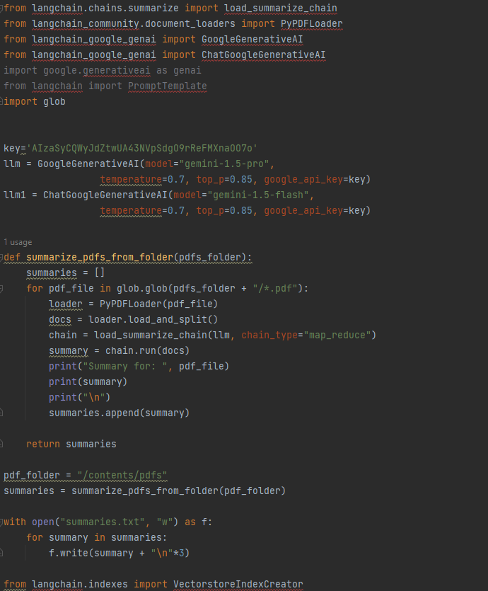
Code Snippets:
Department of Artificial Intelligence and Machine Learning www.Cambridge.edu.in

Slide 15
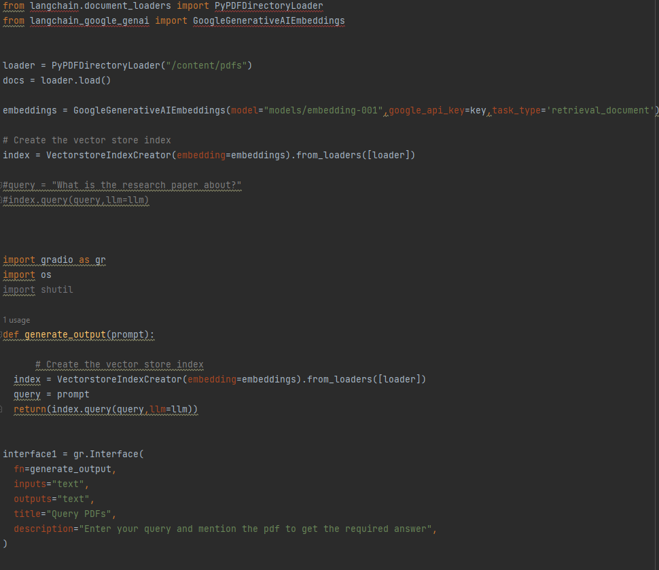
Code Snippets:
Department of Artificial Intelligence and Machine Learning www.Cambridge.edu.in

Slide 16
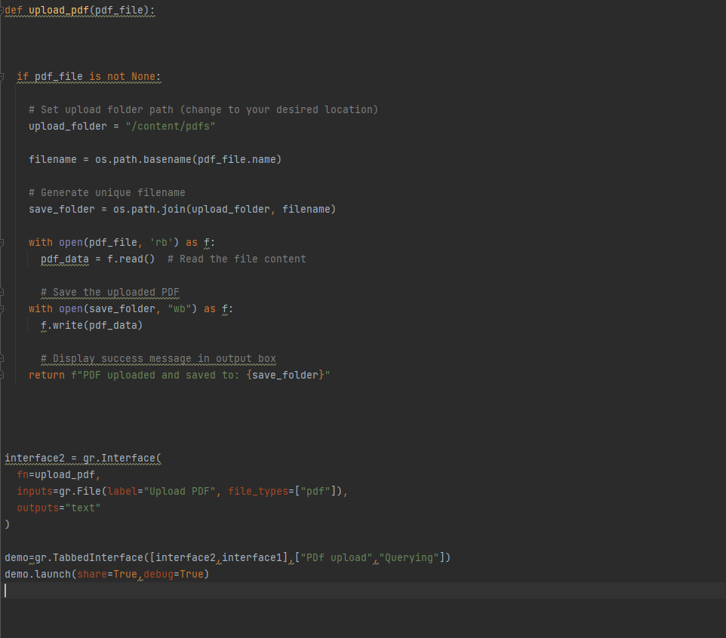
Code Snippets:
Department of Artificial Intelligence and Machine Learning www.Cambridge.edu.in

Slide 17
Future Work:
Handling Larger Datasets: Improve the system's ability to efficiently process and query even larger collections of PDF documents, ensuring performance remains robust as the volume of data increases.
Speed Enhancements: Optimize algorithms and processing techniques to reduce query response times, enabling near-instantaneous retrieval of information.
Complex Query Support: Implement advanced querying features such as multi-criteria searches, Boolean logic, and fuzzy matching to accommodate more sophisticated search needs.
Cross-Document Analysis: Develop capabilities for correlating and analyzing data across multiple document types and formats, including text files, spreadsheets, and databases, to provide a more comprehensive view of the information.
Data Protection: Enhance security measures to ensure that sensitive information within PDFs is protected during the querying and extraction process.
Compliance: Ensure the system adheres to relevant data protection regulations and standards, such as GDPR and HIPAA, making it suitable for use in regulated industries.
Department of Artificial Intelligence and Machine Learning www.Cambridge.edu.in

Slide 18
Conclusion
High Accuracy: The integration of the Gemini model ensures high accuracy in understanding and extracting data from unstructured PDF content, resulting in more precise and reliable information retrieval.
Informed Decision-Making: The ability to quickly and accurately extract information from numerous PDFs supports better decision-making by providing users with comprehensive and relevant insights.
Broad Applicability: This solution is versatile and can be applied across various fields, including academia, business, and government, benefiting researchers, analysts, and professionals who need to handle large volumes of data.
Enhanced Efficiency: By streamlining the process of querying multiple PDFs, the project significantly reduces the time and effort required for data retrieval, making it more efficient for users to access relevant information.
Department of Artificial Intelligence and Machine Learning www.Cambridge.edu.in

Slide 19
References
[1] Y. Shin, J. Kim, K. Jin and Y. B. Kim, "Playtesting in Match 3 Game Using Strategic Plays via Reinforcement Learning," in IEEE Access, vol. 8, pp. 51593-51600, 2020, doi: 10.1109/ACCESS.2020.2980380.
[2] Y. Zhang, S. Li and X. Xiong, "A Study on the Game System of Dots and Boxes Based on Reinforcement Learning," 2019 Chinese Control And Decision Conference (CCDC), Nanchang, China, 2019, pp. 6319-6322, doi: 10.1109/CCDC.2019.8833043.
[3] A. Shantia, E. Begue and M. Wiering, "Connectionist reinforcement learning for intelligent unit micro management in StarCraft," The 2011 International Joint Conference on Neural Networks, San Jose, CA, USA, 2011, pp. 1794-1801, doi: 10.1109/IJCNN.2011.6033442.
[4] G. Gomes, C. A. Vidal, J. B. Cavalcante-Neto and Y. L. B. Nogueira, "AI4U: A Tool for Game Reinforcement Learning Experiments," 2020 19th Brazilian Symposium on Computer Games and Digital Entertainment (SBGames), Recife, Brazil, 2020, pp. 19-28, doi: 10.1109/SBGames51465.2020.00014.
[5] A. J. Almalki and P. Wocjan, "Exploration of Reinforcement Learning to Play Snake Game," 2019 International Conference on Computational Science and Computational Intelligence (CSCI), Las Vegas, NV, USA, 2019, pp. 377-381, doi: 10.1109/CSCI49370.2019.00073.
[6] M. A. Samsuden, N. M. Diah and N. A. Rahman, "A Review Paper on Implementing Reinforcement Learning Technique in Optimising Games Performance," 2019 IEEE 9th International Conference on System Engineering and Technology (ICSET), Shah Alam, Malaysia, 2019, pp. 258-263, doi: 10.1109/ICSEngT.2019.8906400.
[7] A. Akramizadeh, M. . -B. Menhaj and A. Afshar, "Multiagent reinforcement learning in extensive form games with complete information," 2009 IEEE Symposium on Adaptive Dynamic Programming and Reinforcement Learning, Nashville, TN, USA, 2009, pp. 205-211, doi: 10.1109/ADPRL.2009.4927546.
[8] J. Perdiz, L. Garrote, G. Pires and U. J. Nunes, "A Reinforcement Learning Assisted Eye-Driven Computer Game Employing a Decision Tree-Based Approach and CNN Classification," in IEEE Access, vol. 9, pp. 46011-46021, 2021, doi: 10.1109/ACCESS.2021.3068055.
[9] D. Daylamani-Zad and M. C. Angelides, "Altruism and Selfishness in Believable Game Agents: Deep Reinforcement Learning in Modified Dictator Games," in IEEE Transactions on Games, vol. 13, no. 3, pp. 229-238, Sept. 2021, doi: 10.1109/TG.2020.2989636.M. Jeon, J. Lee and S. -K. Ko, "Modular Reinforcement Learning for Playing the Game of Tron," in IEEE Access, vol. 10, pp. 63394-63402, 2022, doi: 10.1109/ACCESS.2022.3175299.
[10] M. Li and W. Huang, "Research and Implementation of Chinese Chess Game Algorithm Based on Reinforcement Learning," 2020 5th International Conference on Control, Robotics and Cybernetics (CRC), Wuhan, China, 2020, pp. 81-86, doi: 10.1109/CRC51253.2020.9253458.
[11] H. Singal, P. Aggarwal and V. Dutt, "Modeling Decisions in Games Using Reinforcement Learning," 2017 International Conference on Machine Learning and Data Science (MLDS), Noida, India, 2017, pp. 98-105, doi: 10.1109/MLDS.2017.13.
Department of Artificial Intelligence and Machine Learning www.Cambridge.edu.in

Slide 20
THANK YOU
Department of Artificial Intelligence and Machine Learning www.Cambridge.edu.in

